Slide 1
Interactive Sales Dashboard – Sample Superstore
Power BI Project Summary
Name: Sayali Vijay Bramhane
Date:14/04/2025

Slide 2
Objective:
To design an interactive dashboard using Power BI Desktop to:
- Analyze sales, profit, discount, and quantity metrics
- Explore regional and product-level performance
- Provide actionable business insights using data
Tools Used: Power BI Desktop
Dataset: Sample Superstore

Slide 3
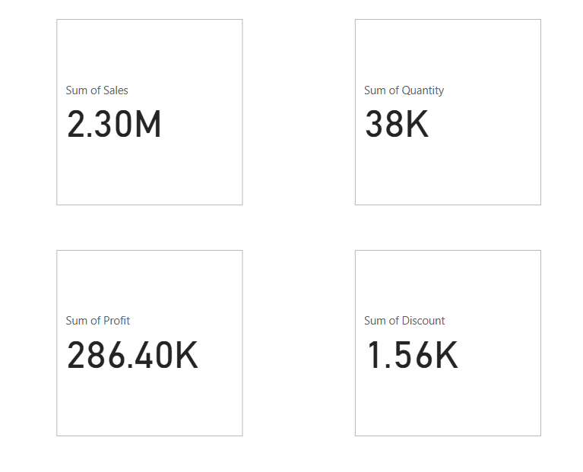
Key Metrics Monitored:
- Total Sales: ₹2.30M
- Total Profit: ₹[286.40K
-Total Quantity Sold: 38K
- Average Discount:1.56K
These KPIs provide a quick summary of overall business performance.

Slide 4
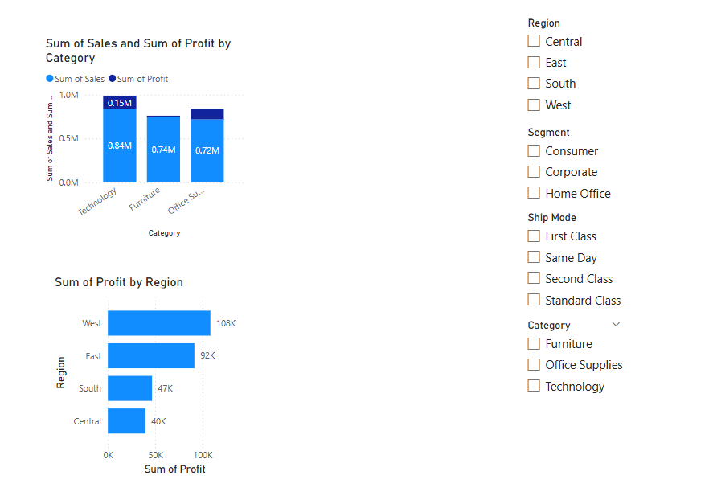
Sales and Profit Overview:
- The Technology category records the highest sales among all sub-categories.
- Office Supplies and Furniture categories show moderate performance.
- Central region contributes the most profit across all regions.

Slide 5
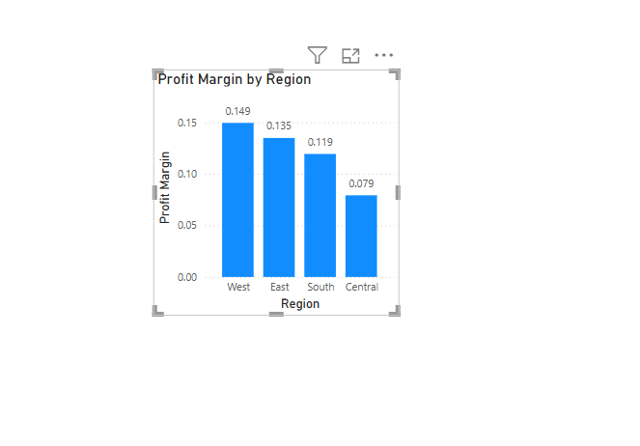
Profitability Insights:
- West and Central regions show strong profit margins.

Slide 6
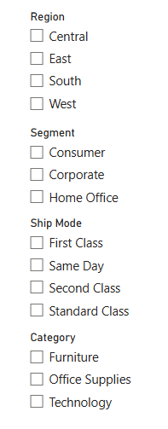
Interactivity in Dashboard:
The dashboard includes slicers for:
- Region
- Segment
- Ship Mode
- Category
These slicers allow users to dynamically explore data and drill down into specific areas of interest.

Slide 7
Key Business Insights:
- Technology category is the top-performing in terms of sales.
- Central and West regions consistently generate the highest profit margins.
- Furniture category has lower profits and high discounts – needs strategic review.
- High discounting does not always increase sales — profitability is impacted.

Slide 8
Conclusion:
The Power BI dashboard helps decision-makers:
- Monitor overall performance with live KPIs
- Explore trends across product categories and regions
- Identify areas for cost-saving and profitability improvement
This dashboard provides an effective data-driven view of sales operations.

